Slide 1

Grouping, Pivoting
LECTURE 17
Extracting and aggregating information from tables.
Spark 10 Spring 2024
Developed by students and faculty at UC Berkeley and Tuskegee University
data6.org/su23/syllabus/#acknowledgements-

Slide 2
Icebreaker
Who do you think would win:
Every Pokémon ever or 1 billion lions

Slide 3
Week 11
Announcements!
Homework 4 due next Wednesday! (Will be available this Wednesday)
Office Hours take place
(Suzanne) Mondays 4:30 - 5:20PM in ACS 366
(Adrien) Wednesdays 4:30 - 5:20PM in ACS 330B
(Jordan) Tuesdays & Thursdays 10-12am

Slide 4
Today’s Roadmap
Grouping with .groupby
Grouping by Multiple Columns
Demo
Lecture 17, Spark 10 Spring 2024

Slide 5
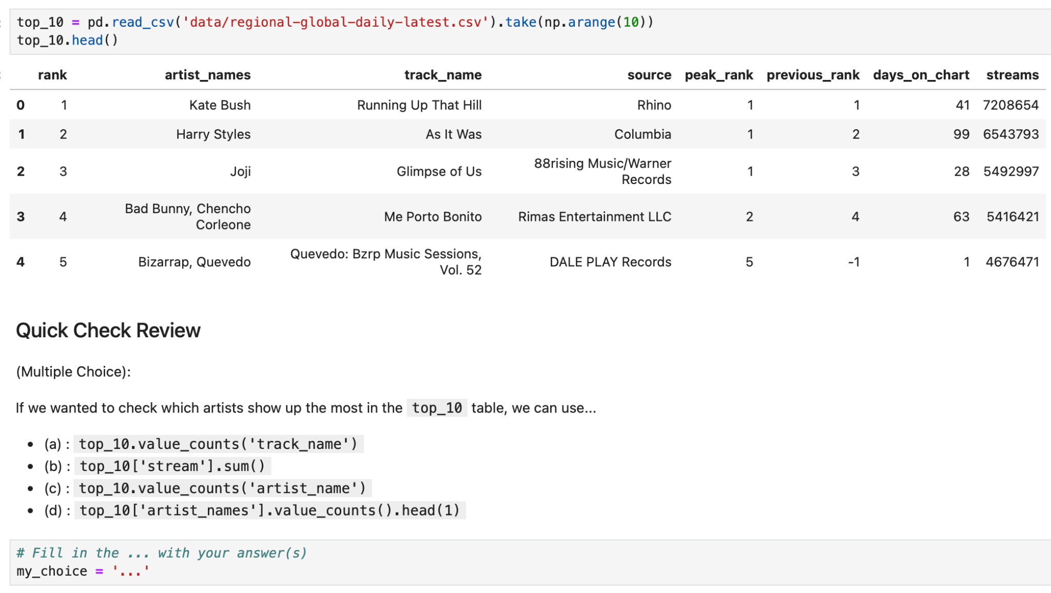
Quick Check Review 1
Choose the most appropriate answer:

Slide 6
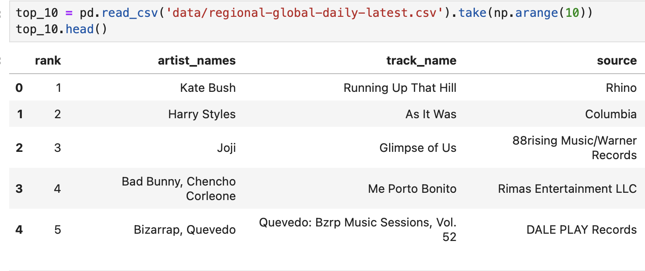
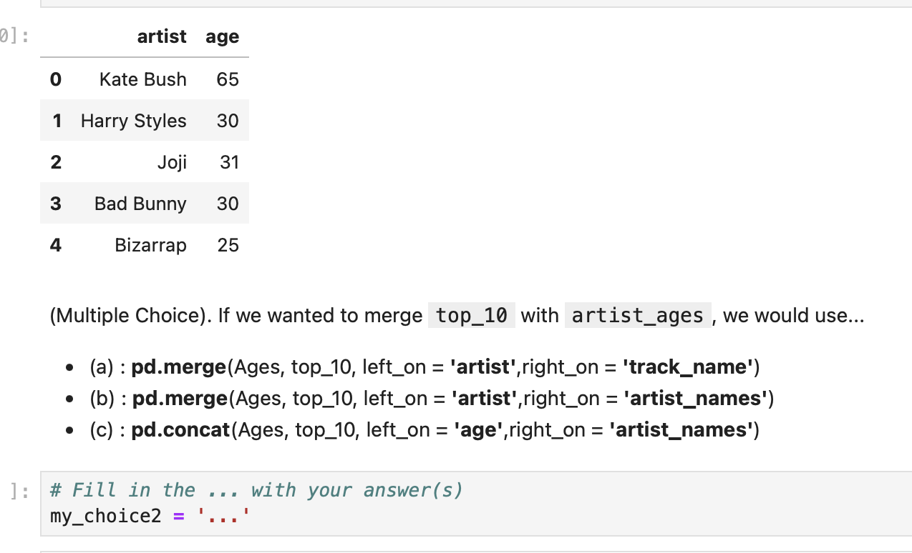
Quick Check Review 2
Suppose we also had the table Ages, which gives the age of all the artists in our dataset.

Slide 7
Grouping with .groupby
➤
1. Grouping with .groupby
2. Grouping by Multiple Columns
3. Demo

Slide 8
Aggregating with .groupby()
The term “group” in data science is most commonly associated with data aggregation and disaggregation.
Aggregation: A process in which information is gathered and expressed in collective or summary form.
Useful for getting information about groups based on variables (age, profession, income) while simultaneously preserving confidentiality of individuals
Disaggregation (aka disentanglement): A process of taking aggregated data and breaking it down into smaller information units.
Useful to highlight outcomes that pertain to individual subsets of results/outcomes (e.g., gender, location, socio-cultural/ethnic background, age groups, etc.) to expose hidden trends
Source
Notes:
https://www.nccih.ca/docs/context/FS-ImportanceDisaggregatedData-EN.pdf

Slide 9
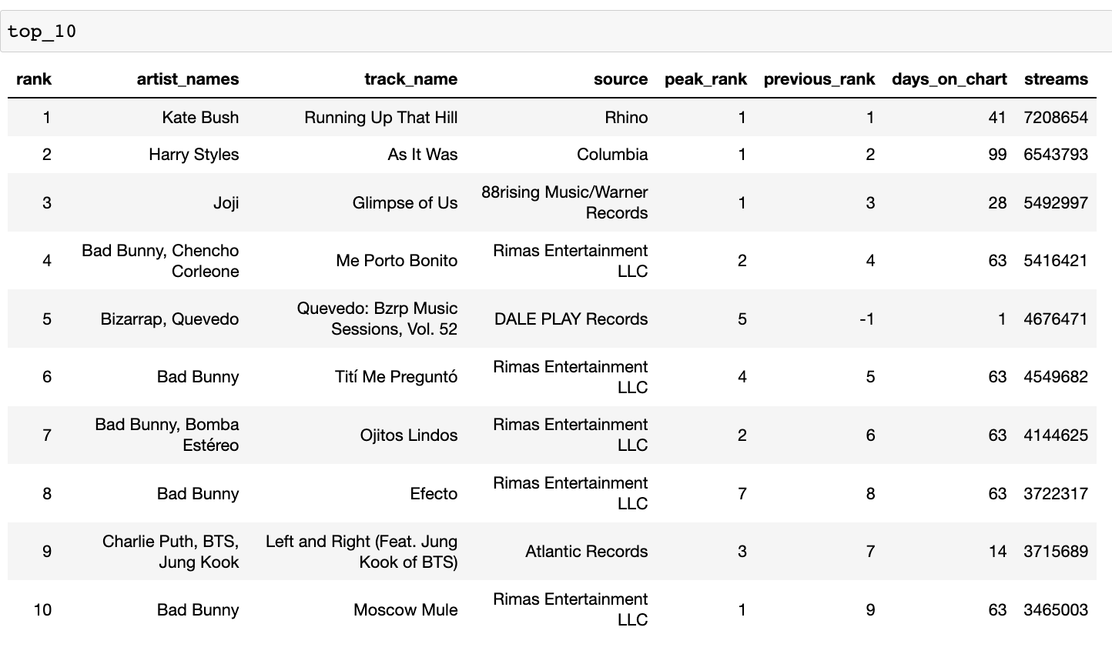
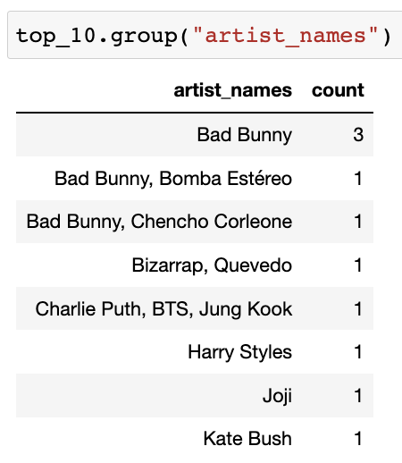
.groupby()
Back to the Spotify data.
Question: What is the relationship between the table on the right and the table on the left?
Answer: Same data, different unit of analysis. The right table is an aggregated view of the left table, grouped by artist.

Slide 10
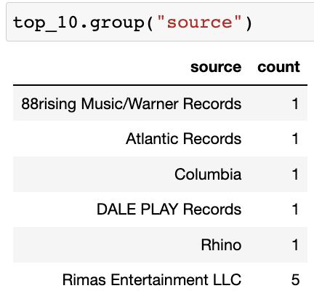
.groupby()
There are 3 Bad Bunny’s in the 'artist_names' column.
Note the exact match!
The method df.value_counts(column) counts the number of rows for each unique value in column, and returns a two-column table with the results.
Note: df.value_counts(column) only keeps the column column, the frequency counts, and no others.

Slide 11
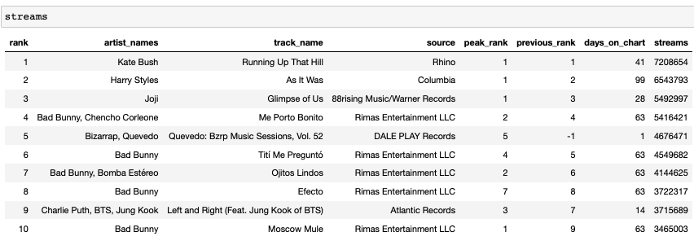
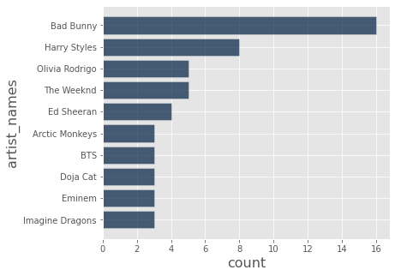
Quick Check 1
Fill in the blanks to create the “Top 10 Artists” bar chart: The 10 artists with the most songs in the Spotify Daily Top 200 streams table.
top_10_artists = streams.value_counts(...)
.take(np.arange(...))
top_10_artists.plot.barh(...)

Slide 12
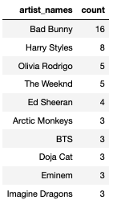
sort_values + take = ❤️
This is a common pattern: grouping and then sorting, and then taking.
Here, it gives us the 10 artists with the most songs in the Spotify Daily Top 200 streams table.
top_10_artists = streams.sort_values('artist_names').take(np.arange(10))
top_10_artists.plot.barh('artist_names')

Slide 13
Advanced Grouping
1. Grouping with .groupby
2. Grouping by Multiple Columns
3. Demo
➤

Slide 14
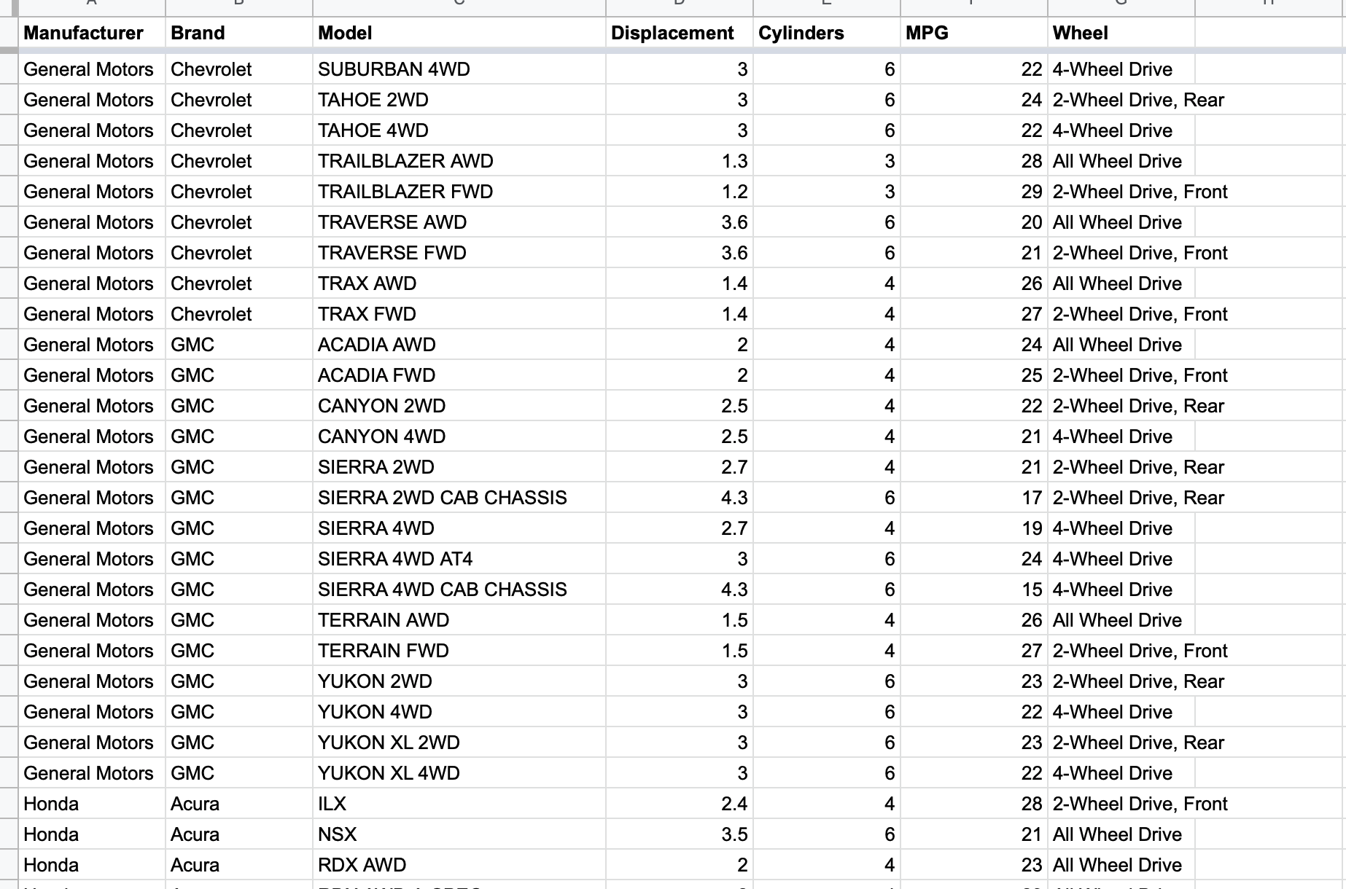
Today’s Data: 2021 Cars
Today we’ll use data from the US Department of Energy that contains basic information about all 2021 model-year cars sold in the US.
Click here for the source.
Click here for a spreadsheet version of the data.
Note:
Manufacturer is who owns the Brand.
GM owns Buick, Cadillac, Chevrolet, GMC.
Displacement is the engine size in liters.
MPG is miles per gallon.

Slide 15
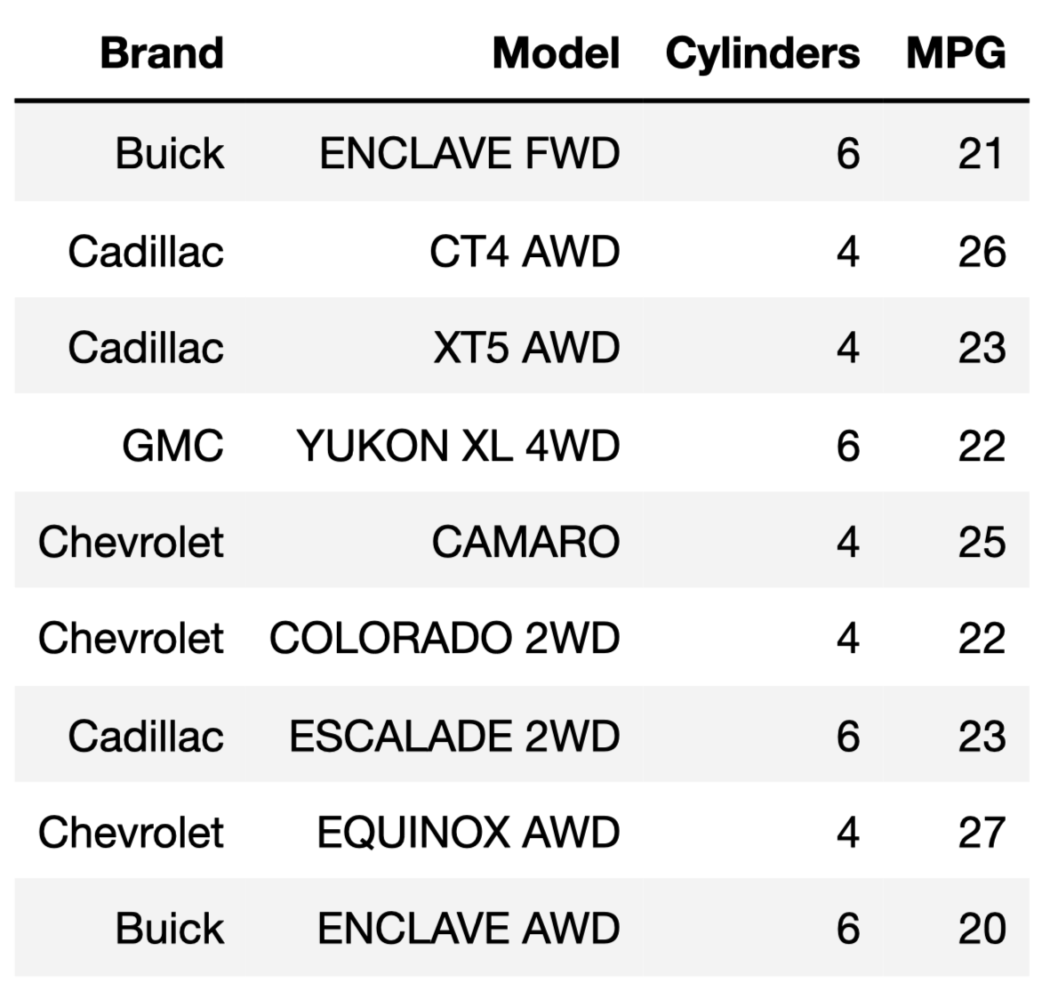
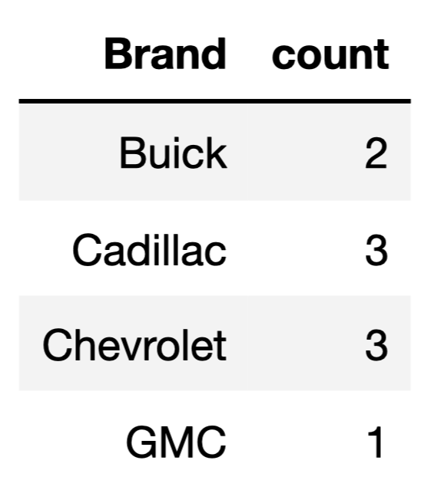
Question: What is the relationship between the table on the right and the table on the left?

Slide 16
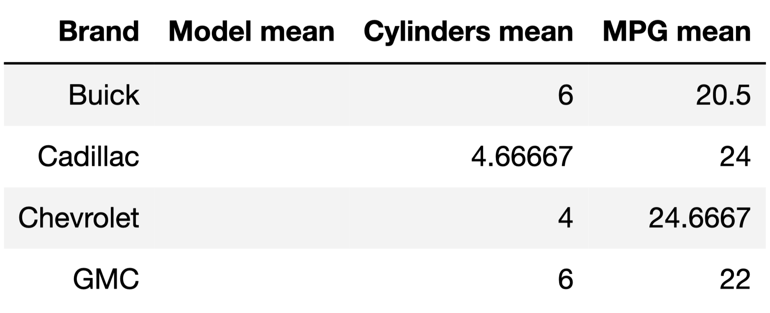
Question: What is the relationship between the table on the right and the table on the left now?

Slide 17
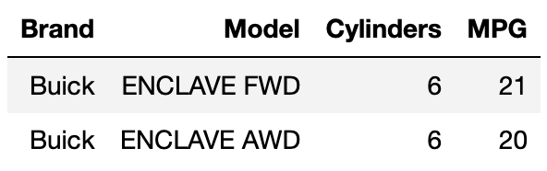
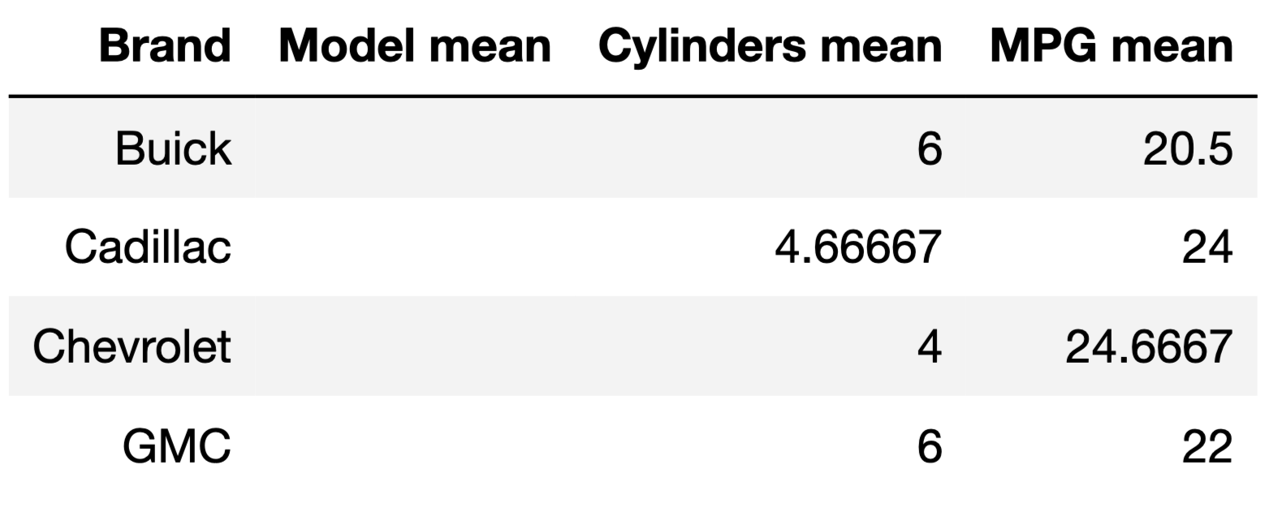
mean:
6
20.5

Slide 18
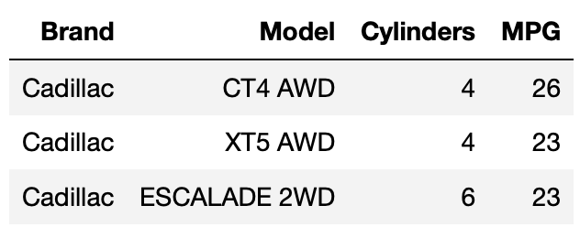
mean:
4.67
24

Slide 19
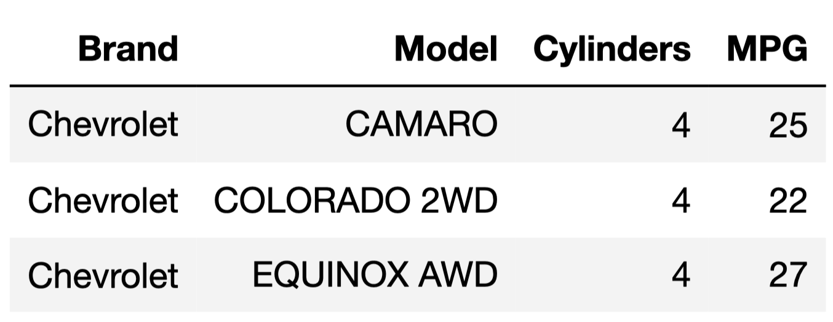
mean:
4
24.67

Slide 20
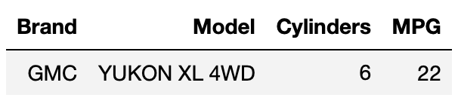
mean:
6
22
gm.groupby('Brand').mean(numeric_only = True)

Slide 21
.groupby
The method df.groupby(column).agg(collect) combines/aggregates all rows with the same value for column into a single row in the resulting table, according to the function collect.
The collect argument is a function.
len: number of grouped values (default).
list: list of all grouped values.
sum: total of all grouped values.
‘mean’: average of all grouped values.
collect can be function that works on arrays!
You can write your own functions if you need to.

Slide 22
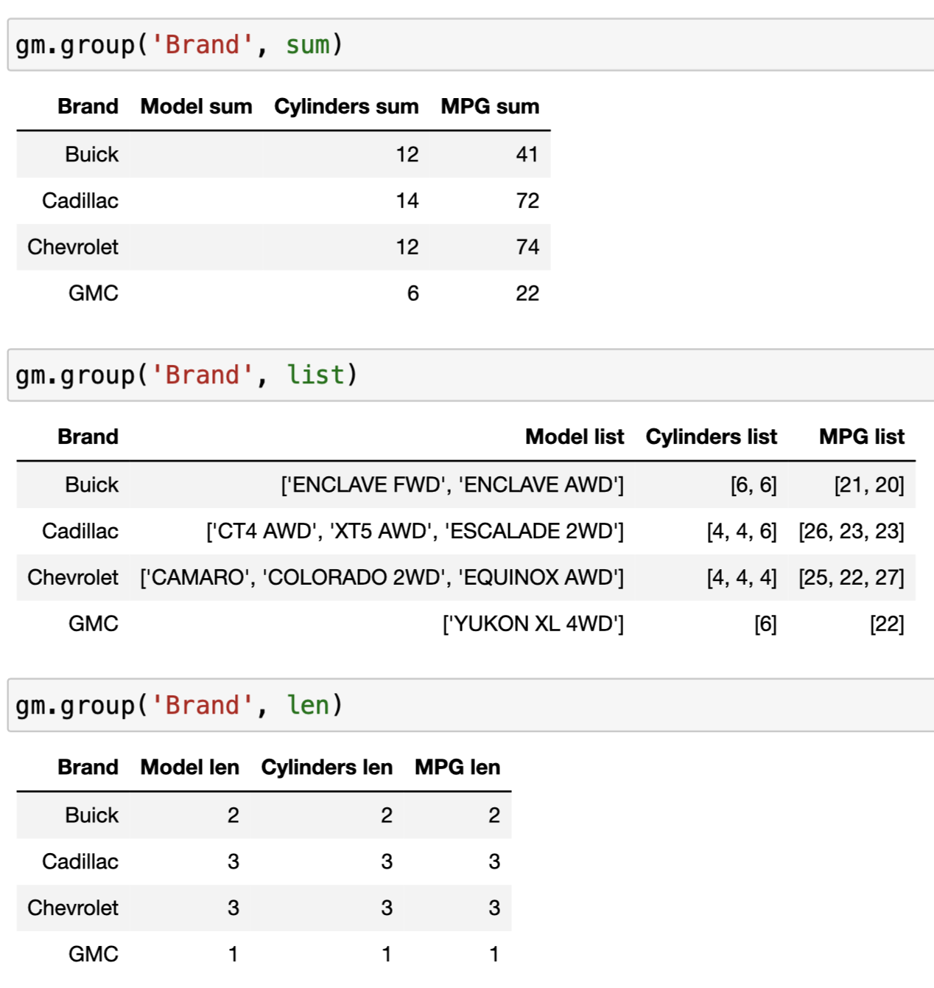
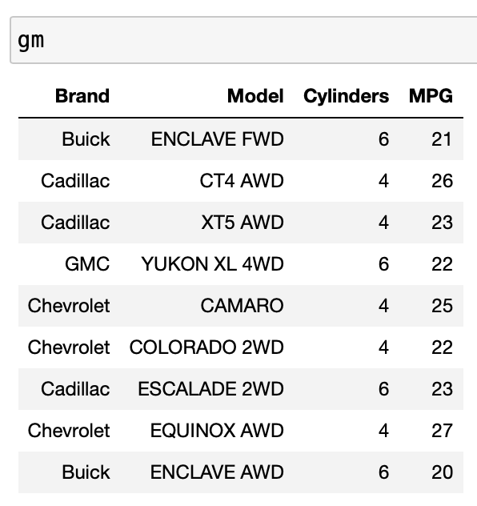
Example
You can’t sum strings, so the 'Model sum' column is empty.
We get the same numbers (2, 3, 3, 1) if we don’t specify a collect function.

Slide 23
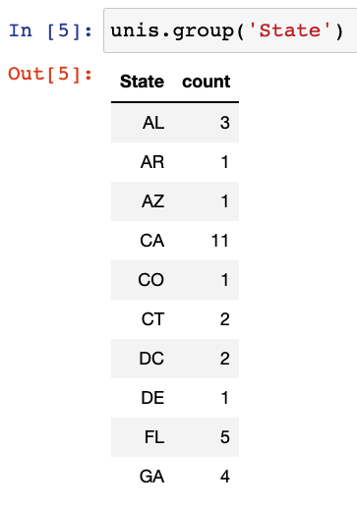
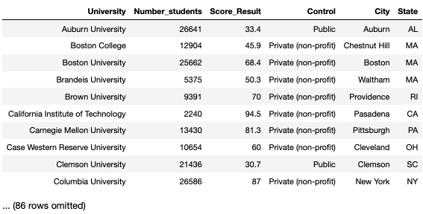
Translating Between Units of Analysis
Suppose we have data on 4-year R1 higher education institutions across the United States.
aggregation
?
Disaggregation is impossible unless we have data at a finer-grained unit of analysis to begin with.
disaggregation
e.g. by race/ethnicity

Slide 24

Which Columns Should We Group By?
It usually only makes sense to group by columns that store categorical information that is shared across multiple rows.
If you had a bunch of dogs, you could group by
Breed.
Size (small, medium, large).
Sex.
Color.
It wouldn’t make sense to group by weight in pounds, since every dog will have a slightly different weight and two dogs having the exact same weight doesn’t tell you much.

Slide 25
Questions?

Slide 26
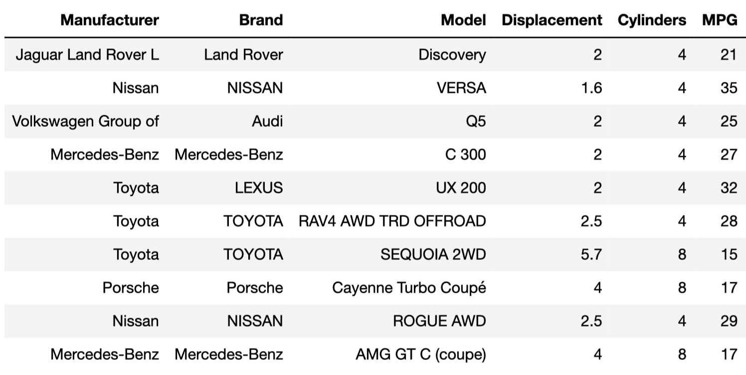
Quick Check 2
Fill in the blanks so that the following evaluates to the average miles per gallon for all 6-cylinder vehicles in cars.
cars.groupby('Cylinders') \
.where(____ == 6) \
.column(____) \
.____

Slide 27
Grouping by Multiple Columns
1. Grouping with .group
2. Grouping by Multiple Columns
3. Pivot Tables with .pivot
➤

Slide 28
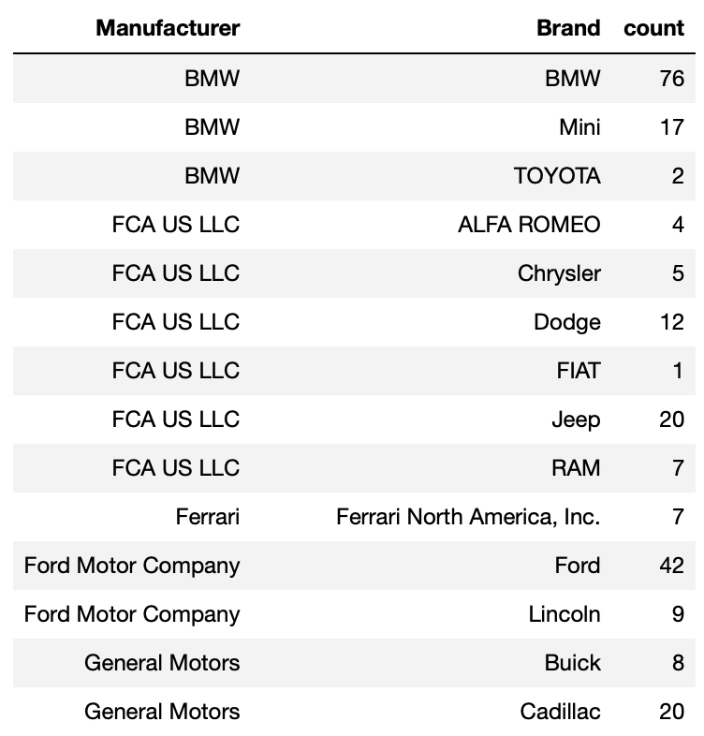
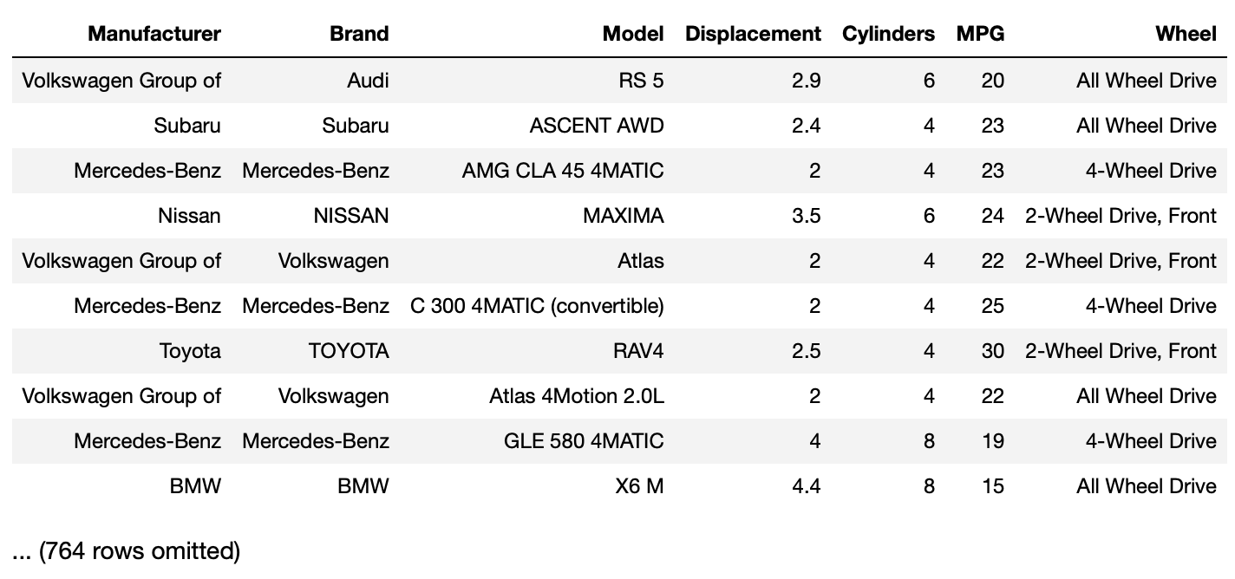
Question: What is the relationship between the table on the right and the table on the left?

Slide 29
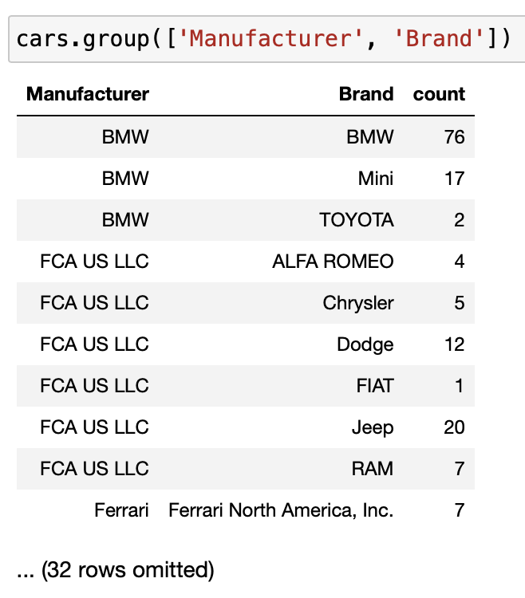
Grouping by Multiple Columns
One row for every combination of Manufacturer and Brand.
If we pass a list of column names as the first argument to group:
df.groupby(column_or_columns).agg(collect)
the resulting table has one row for every unique combination of values in the specified columns.
Just as before, if we call groupby with a single argument (a list or array), we get back counts. We can specify a collect function if we want to.

Slide 30
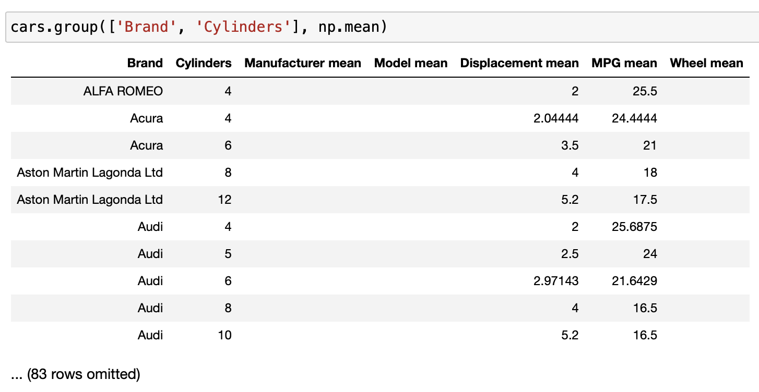
Average MPG for all 4 cylinder Audis.
Question: What do the numbers in this table mean?

Slide 31
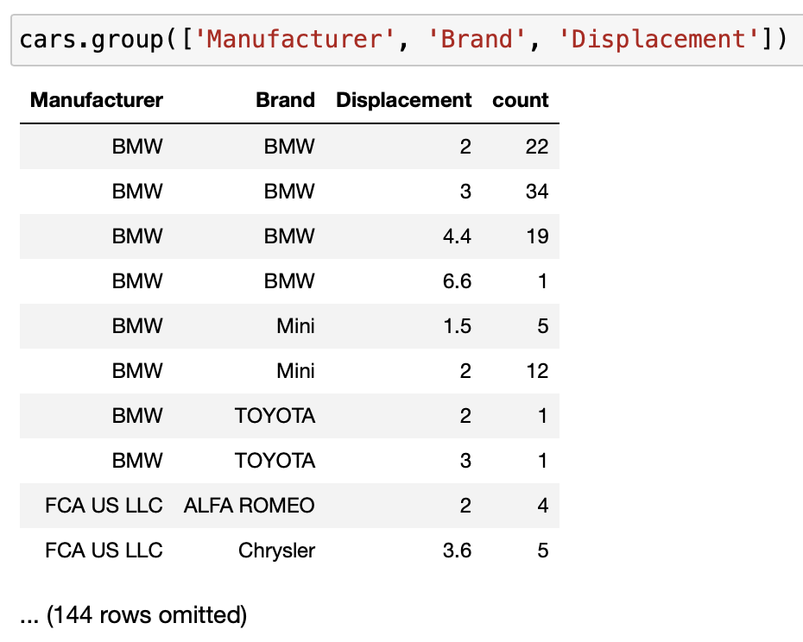
Grouping by More Than Two Columns
You can group by any number of columns, but we rarely group by more than two columns as the results tend to be less meaningful.
Here, Manufacturer doesn’t tell us much.

Slide 32
Demo
1. Grouping with .group
2. Grouping by Multiple Columns
3. Demo
➤

Slide 33
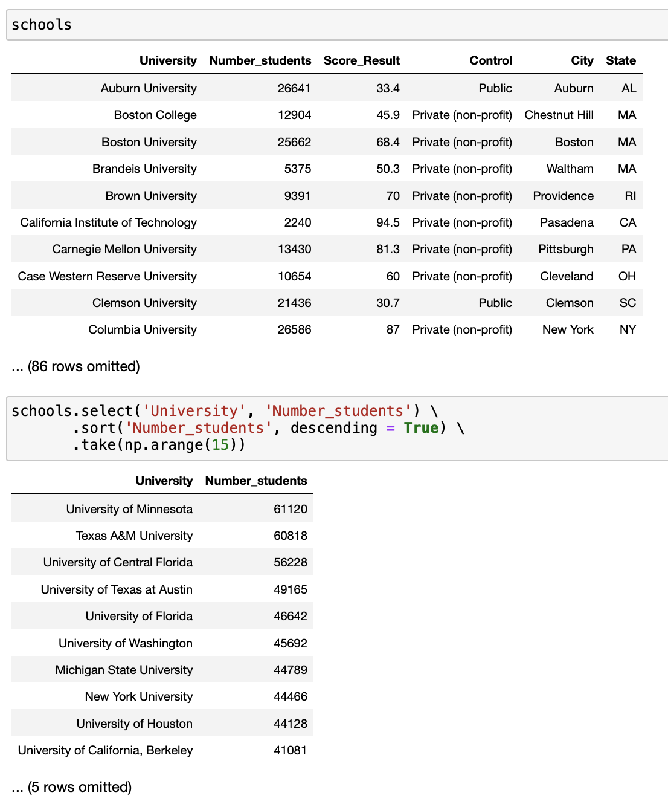
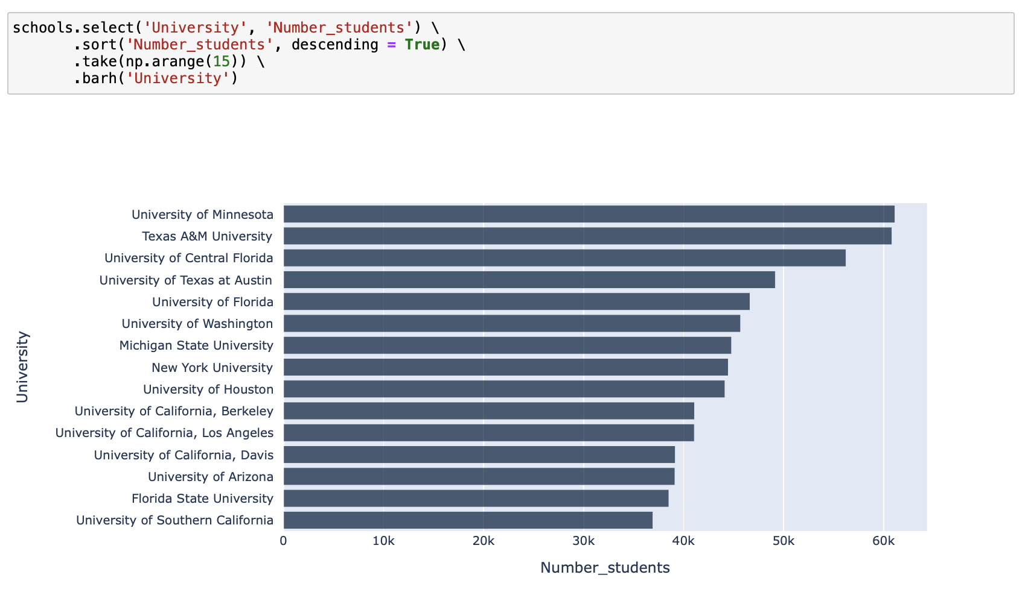
No need to group here; the University column of the schools table is unique to begin with.

Slide 34
Resources
Grouping can be quite complicated! In addition to the usual documentation and readings, you may want to refer to this:
Groupby Animation.

Slide 35
In Conclusion…

Slide 36
Summary
Method | Behavior
df.groupby(column_or_columns).agg(collect) | If column_or_columns is a single label: returns a table with one row for every unique value in the column. Values in other columns are combined by the function collect, which is len by default. If column_or_columns is an array: returns a table with one row for every unique combination of elements in the list. Values in other columns are combined by the function collect, which is len by default.

Slide 37
Recap
Next Time
Grouping
Grouping with multiple columns
Applying Functions to Columns
pivoting

Slide 38
Week 11
Announcements!
Homework 4 due next week! (Will be available this Wednesday)
Office Hours take place
(Suzanne) Mondays 4:30 - 5:20PM in ACS 366
(Adrien) Wednesdays 4:30 - 5:20PM in ACS 330B
(Jordan) Tuesdays & Thursdays 10-12am

